Slide 1



Communicate On The Telephone
D1.HRS.CL1.04 D1.HOT.CL1.07 D2.TCC.CL1.05
Notes:
Trainer welcomes students to class.

Slide 2

Communicate on the telephone
This Unit comprises two Elements:
1. Respond to incoming telephone calls
2. Make telephone calls.
Notes:
Trainer advises students this Unit comprises two Elements, as listed on the slide explaining:
Each Element comprises a number of Performance Criteria which will be identified throughout the class and explained in detail
Students can obtain more detail from their Trainee Manual
The course presents advice and information but where their workplace requirements differ to what is presented, the workplace practices and standards must be observed.

Slide 3

Assessment
Assessment for this Unit may include:
Oral questions
Written questions
Work projects
Workplace observation of practical skills
Practical exercises
Formal report from employer/supervisor.
Notes:
Trainer advises students that assessment for this Unit may take several forms all of which are aimed at verifying they have achieved competency for the Unit as required.
Trainer indicates to students the methods of assessment that will be applied to them for this Unit.

Slide 4
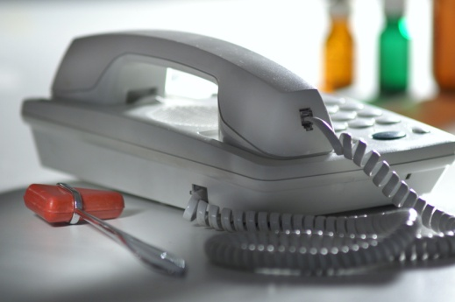
Respond to incoming telephone calls
Performance Criteria for this Element are:
1.1 Answer calls promptly in an appropriate manner in accordance with enterprise standards
1.2 Offer friendly assistance to the caller and accurately establish the purpose of the call
1.3 Repeat call details to the caller to confirm understanding
1.4 Answer caller enquiries promptly or transfer caller to the appropriate location or person
(Continued)
Notes:
Trainer identifies for students the Performance Criteria for this Element, as listed on the slide.

Slide 5
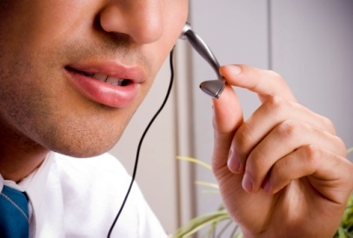
Respond to incoming telephone calls
1.5 Record caller requests accurately and pass on to the appropriate department or person for follow-up
1.6 Relay messages accurately to the nominated person within designated timelines
1.7 Report threatening or suspicious phone calls promptly to the appropriate person in accordance with enterprise procedures
1.8 Use language, tone and volume appropriate to phone calls.
Notes:
Trainer continues to identify the Performance Criteria for this Element, as listed on the slide.
Class Activity – General discussion
Trainer leads a general class discussion on responding to incoming calls in the workplace asking questions such as:
What experience have you had of taking incoming telephone calls at work?
What sort of telephone system/s have you used?
What workplace requirements are you aware of in relation to the use of the telephone?
How should you answer an incoming call? What should you say?
How important is the telephone for a business?
What good or bad experiences have you experienced when someone at a business has answered a call you have made to them?

Slide 6


Answering calls promptly
Customers can use the phone to:
Make reservations for rooms, tours and travel
Check, query, modify or cancel arrangements already made
Make enquiries about functions
Seek information about prices and products
Lodge compliments and complaints.
Notes:
Trainer states to students that nearly everyone thinks they can use a telephone competently because they all use one on a regular basis in their everyday, private lives highlighting that using a telephone in a workplace situation is completely different to using the telephone at home or using a cell phone.
Trainer explains to students that the telephone is vital to the operation of any business and is used by customers to contact the business for a variety of reasons such as to:
Make reservations for rooms, tours, travel and dining
Check, query, modify or cancel arrangements already made in relation to bookings, meetings, quotations etc
Make enquiries about functions and other services, products, facilities etc. the business offers
Seek information about prices and products including special deals, promotional packages, limited time offers
Lodge compliments and complaints regarding products and/or service they have received.

Slide 7
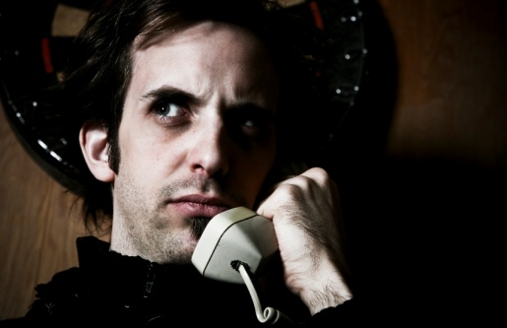
Answering calls promptly
Failure to answer the telephone promptly and correctly can result in:
Loss of business or revenue
Loss of jobs
Poor or negative customer relations
Customers who are more difficult to deal with
Reduced business image in the eyes of customers.
Notes:
Trainer explains the potential negative consequences of not answering the workplace phone promptly or correctly highlighting this may result in:
Customers taking their business elsewhere meaning loss of revenue for the business, and loss of jobs for staff
Poor customer relations meaning customers may be annoyed with the organisation and be more difficult to deal with or sell to
Reduced company image – the image of the business will be adversely impacted by poor telephone techniques.

Slide 8

Answering calls promptly
Staff also use the phone on behalf of customers and for business reasons to:
Communicate with other staff or departments
Seek clarification about work directions
Contact nominated people in the event of an emergency situation
Provide feedback to management and co-workers
Obtain help or stock
(Continued)
Notes:
Trainer explains to students that the telephone is also important for the business because it is used by staff to undertake numerous activities on behalf of both the business and its customers highlighting these activities may include:
Communicate with other staff or departments to pass on information, to advise of changed circumstances or arrangements and to find out information to use in their work
Seek clarification about work directions, such as identifying work priorities, obtaining resources to do their work or having unclear instructions explained
Contact nominated people in the event of an emergency situation, such as when there is a difficult customer, a fire or a medical emergency
Provide feedback to management and co-workers about service and customers, complaints, issues requiring attention (maintenance of equipment, products or services that customers do not like)
Obtain help or stock where unexpected levels of demand or trade occur and stock runs out, or extra help in dealing with customers is required.

Slide 9
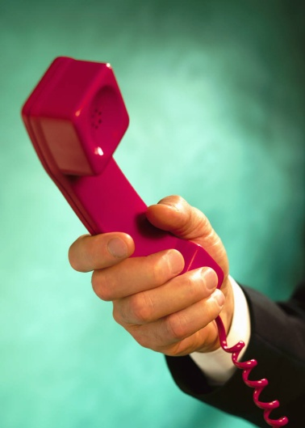
Answering calls promptly
Order stock from suppliers
Make bookings with providers
Cold call prospects
Place service or maintenance calls with support organisations
Seek advice from government authorities, industry bodies, and a range of business advisors.
Notes:
Trainer continues to explain to students the ways in which staff can use the workplace telephone:
Order stock from suppliers. These are the resources and requirements a business needs to supply its customers
Make bookings with providers to reflect bookings made with them by their customers. While many bookings will be processed online there are frequent occasions when it is necessary to ring a provider and discuss a booking to make sure it is processed as required
Cold call prospects to generate sales or create bookings
Place service or maintenance calls with support organisations to arrange service, maintenance, repairs to workplace equipment, systems and technology
Seek advice from government authorities, industry bodies, and a range of business advisors to address needs related to a wide variety of operational needs such as security, legal, accounting and marketing/advertising.

Slide 10
Answering calls promptly
Every time you use the phone at work you are the business
Callers – and people you call – judge the business by the way you handle the call
Common, big mistakes telephone users make is to:
Not answer calls promptly
Take the telephone for granted
Believe use of the telephone comes ‘naturally’.
Notes:
Trainer urges students to remember that every time they use the telephone – whether this is to answer a call, or make a call – they are the business. Big mistakes workplace telephone users make is to:
Not answer calls promptly – calls should be answered as quickly as possible
Take the telephone for granted meaning they fail to pay sufficient attention to, and care with, the way they handle and process calls
Believe their use of the phone comes naturally to them and believe they do not need training in its correct use.

Slide 11

Answering calls promptly
An appropriate telephone manner must be applied when using the telephone:
Using polite language at all times
Using appropriate welcoming or greeting phrases
Showing enthusiasm when taking a call
Being friendly
Making an offer of help to the caller.
Notes:
Trainer advises students it is essential they use an appropriate telephone manner when using or answering the telephone, which includes:
Using polite language at all times regardless of the language being used by the caller [more information presented on later slides]
Using appropriate welcoming or greeting phrases as set by the employer. The style of the greeting should reflect the style of business involved [more information presented on later slides]
Showing enthusiasm (that is, a positive attitude or approach to the call) when taking a call. This is to demonstrate that the business is eager to talk to the caller and to do business with them
Being friendly. It is important for all those who take telephone calls to understand the need to be friendly to all callers. This friendliness while on the telephone has been referred to as the need to ‘put a smile in your voice’ when talking on the telephone. Some recommend placing a mirror near the telephone or on the desk to remind users to smile while on the phone
Making an offer of help to the caller. A standard requirement when answering all telephone calls is to either ask the caller a direct question enquiring what assistance the caller wants, or have a positive predisposition towards providing whatever help the caller asks for [more information presented on later slides].

Slide 12
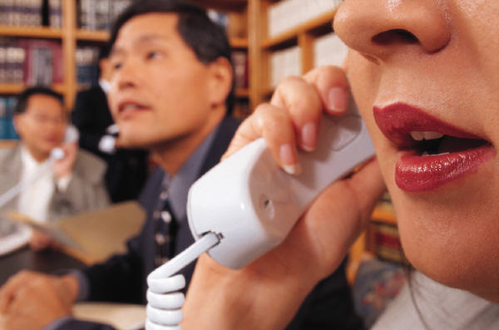
Answering calls promptly
You will become aware of your workplace ‘enterprise standards’ for answering or using the telephone in the following ways:
On-the-job training
Personal observation
Reading company policy on Telephone Use or Operation
Reading relevant section of Employee’s Handbook.
Notes:
Trainer advises students the enterprise standards that apply for answering or using the telephone in their workplace will be provided to them in one or more ways including:
On-the-job training – a formal course provided by the employer
Personal observation – listening to what others do or say
Reading the company policy on ‘Telephone Use/Operation’ (or similar) which will detail the exact requirements for all telephone use within the organisation
Reading the ‘Employee’s Handbook’ (or similar) which will provide a short-form of enterprise requirements and commonly contains sample phrases (such as greetings to use when answering a call, phrases to use when transferring a call and farewells to use when ending a call).
Class Activity – Consideration of workplace policies
Trainer obtains from local businesses a range of policies relating to Telephone Use and Standards and:
Shares these with students
Discusses them, highlighting specific workplace requirements
Identifies reasons behind workplace requirements as stated in the policies
Highlights policy requirements that differ from the way individuals us or answer a phone in their personal life.

Slide 13
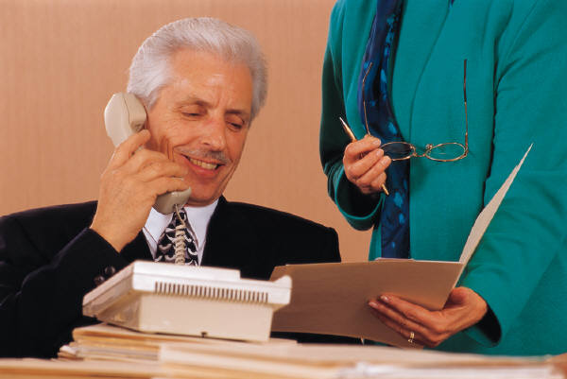
Answering calls promptly
Enterprise standards may relate to:
The use of appropriate greetings or welcoming phrases when answering the telephone. These may require you to:
Greet the caller
Identify the business
Identify yourself
Make an offer of assistance
It is never acceptable to simply pick up the phone and say:
“What?”, “Yes” or “Hello”.
(Continued)
Notes:
Trainer advises students that ‘enterprise standards’ can vary between businesses but are similar in nature, highlighting they will normally require staff to make a standard statement when answering the phone in which they may, for example, require them to:
Greet the caller which may include a welcoming phrase dependent on the time of day: such as “Good morning”, “Good afternoon” or “Good evening”
Identify the business by the name advised by management. For example, the trading name of the business may not be the name management wants staff to use when answering the phone
Identify yourself following the nominated preferences of the business: for example, using either first or surname (or both)
Make an offer of assistance using a simple statement such as “How can I help you?”, “Where can I direct your call?” [more on later slides].

Slide 14
Answering calls promptly
Use of the caller’s name
Making an offer of assistance :
Make an initial offer of help to the caller
Be responsive to directing the call :
“It sounds as if you need to talk to our Function department Manager, Mr Maguire. I’ll connect you to Mr Thomas, our Banquet Manager”
“I think you need to talk to Peter, he’s in charge of reservations”
Take a message :
“I’m sorry Mr Smith, Mr Grey is unavailable at the moment. Can I take a message and get him to ring you back?”
Do not answer someone else’s extension or phone.
Notes:
Trainer continues to advise students about the possible requirements of enterprise standards as they relate to using or answering the workplace telephone:
Use of the caller’s name. When you know the name of the person calling it is standard practice to use that name throughout the duration of the call. It is often said everyone likes to hear the sound of their own name (so using the caller’s name is a positive thing to do), and it demonstrates to the caller you have taken the trouble to remember who they are. Using their name personalises the call.
Making an offer of assistance. When taking a telephone call you must always be alert to the need to (as appropriate):
Make an initial offer of help to the caller – as identified on previous slide
Be responsive to directing the call in accordance with the initial information provided by the caller:
“It sounds as if you need to talk to our Function department, Mr Maguire. I’ll connect you to Mr Thomas, our Banquet Manager”
“I think you will need to talk to Peter. He’s in charge of reservations”
Take a message if the person the caller needs to speak with is unavailable [more on later slides]:
“I’m sorry Mr Smith, Mr Grey is unavailable at the moment. Can I take a message and get him to ring you back?”
Do not answer someone else’s phone. Let the call be taken by an answering machine. Let it be automatically diverted by the system to another extension.
Class Activity 1 – Demonstration
Trainer uses Training Institute telephone system to show students how to answer the telephone in an acceptable manner using an assortment of appropriate enterprise standards.
Class Activity 2 – Role plays/practical exercises
Trainer presents students with several ‘workplace situations’ (describing time of day, name of the business the student represents etc.) and:
Plays the role of a customer and calls students in class using a Training Institute extension/telephone
Asks students to answer the call promptly and in an appropriate manner
Provides feedback to students after the role plays/exercises.

Slide 15

Answering calls promptly
When placing a call ‘on hold’:
Do it courteously
Ask the caller if they want to be placed ‘on hold’
Listen to their answer and act accordingly
Get back to all calls ‘on hold’ every 30 seconds.
Notes:
Trainer explains to students that when a need arises to place a call ‘on hold’ they should:
Do it courteously following all applicable enterprise requirements
Ask the caller if they want to be placed ‘on hold’ . Some callers may prefer not to be placed on hold. They may prefer to ring back or they may want you to take a message
Listen to their answer. When you have asked a caller if they wish to be placed on hold while you make enquiries you must listen for their response to the question. Never assume the caller will want to hold
Get back to all calls on hold every 30 seconds to advise them of your progress and to let them know you have not forgotten them so they know their call has not been disconnected.

Slide 16

Offering assistance and establishing the purpose of the call
Always use a friendly tone when answering the phone
The key to answering caller enquiries is to be genuinely helpful:
Focus just on the call
Try to understand the caller’s problem or situation
Ask questions
Put yourself in the caller’s shoes
Take time with the call
Check the caller’s level of satisfaction with what is being provided and what is happening with their call.
Notes:
Trainer reminds students that callers cannot see their facial expressions (that is, callers cannot read their body language to assist with the communication) when they telephone so this means it is more important for staff to use their voice appropriately.
Trainer mentions that at all times, callers must be spoken to in a friendly tone (‘put a smile in your voice’) and assistance must be offered when and where necessary without giving the impression that doing so is an imposition.
Trainer highlights to students the key to answering queries is to be genuinely helpful which encompasses:
Focusing on the call to the exclusion of other work: do not get distracted
Trying to understand the caller’s problem/s so your response or action is appropriate to the needs of the caller
Asking questions to obtain more information to assist in providing relevant help
Putting yourself in the caller’s shoes by seeing things from the caller’s perspective
Taking time with the caller by not rushing the call or giving the impression you are eager to move on to another call or to other work
Checking the caller’s level of satisfaction with what is happening, has been provided or is being suggested and altering service provision as necessary to improve service delivery.

Slide 17
Offering assistance and establishing the purpose of the call
When you have provided an appropriate greeting and welcome you need to:
Quickly identify why the caller has phoned:
Ask questions
Never assume anything from one or two words spoken by the caller
Use active listening
Take brief notes.
Notes:
Trainer explains to students that the first step after providing an acceptable greeting to the caller is to quickly establish the purpose of the call, highlighting they must never assume they know why the caller has phoned and stressing they must always be on their guard to prevent listening to just one or two words the caller says and jumping to a wrong conclusion about the reason for the call in the mistaken belief they think they are being helpful.
Trainer gives an example of the problem of assuming you know what the caller wants:
For example a caller says “I’m ringing about a reservation in the Grill Room” shouldn’t immediately be transferred to the Grill Room. They may have wanted to go on to say “I had a booking there the other night and there was a mix-up with it: I want to speak to the manager to make a complaint.”
Trainer explains to students keys in making sure they correctly establish the purpose of a call before processing it include:
Asking questions. It is common for people who answer telephone calls to have to ask the caller questions to better determine how or where to process their call. This is because the caller often fully understands what they want to say or who they want to talk to but they fail to convey this and appear to assume you know what they want to talk about and who they need to speak with.
Listening to information given by the caller. This highlights how critical it is for those who take incoming telephone calls to apply ‘active listening’ techniques and focus completely on the words being spoken by the caller
A useful strategy when establishing the purpose of a call is to jot down notes about what the caller is talking about. This provides a visual reference that jogs the memory and always helps to determine what the caller wants and where their call should be transferred.

Slide 18

Repeating call details
It may be necessary to repeat call details to the caller to confirm or clarify the purpose of the call from the caller’s perspective.
Repeating call detail requires:
Awareness this may need to be done
Awareness the caller never knows the business the way you do
Stating back to the caller what you believe they have said, what they want or what they have asked for
Asking questions.
Always keep the caller advised of what you are going to do.
Notes:
Trainer explains to students that it may be necessary to repeat call details to confirm or clarify understanding regarding caller requirements, to save valuable time for the caller and make sure the call is connected to the right person or department.
Trainer identifies that confirming understanding of caller requirements involves:
Awareness this may need to be done. Repeating call details is not required for every call but there is always a requirement you remain alert to the possibility you may need to clarify or confirm call details
Awareness the caller never knows your workplace in the same detail you do. They may have no understanding at all, or some understanding but they will never know your workplace to the same extent you do (that is, all the policies and procedures; staff names, roles and responsibilities; options, prices, deals etc.)
Stating back to the caller what is they have said, asked for or requested to make sure you have it right and to give them a chance to clarify and/or add more detail or information
Asking questions to obtain more detail where the caller has not provided it, or to clarify points where the caller was unclear in what they said or asked for.
Trainer advises students they should always keep callers informed about what they intend doing in relation to their call. This may include:
Advising them you can help them, take their booking, provide the information they are seeking
Informing them you are going to transfer their call to a nominated department or person
Asking if they would like to hold while you obtain required information.

Slide 19

Repeating call details
When taking a telephone reservation (for travel, tours, rooms, dining), make sure you:
Capture the basic information about the booking
Record information into appropriate register or on to appropriate system
Apply standard customer service techniques
Apply standard sales techniques.
Notes:
Trainer advises students that most requests for a reservation will be forwarded to the appropriate area or person for them to handle stating this procedure is most effective because it allows the appropriate staff member to obtain extra information from the caller, arrange the best reservation for the caller and confirm (or deny) the booking.
Trainer indicates to students that where they are required to take a phone call and process a reservation as part of that call they must pay attention to:
Capturing all relevant details applicable to the type of reservation being processed, which may include:
Day and date: both should be confirmed as a means of making sure the correct date is being provided
Time – checking about AM or PM and using the 24-hour clock in many cases
Names – with special attention paid to capturing all relevant names and ensuring the spelling of people’s names and business names is correct
Numbers involved in the booking and, where appropriate, noting gender and ages (especially where it is important to differentiate between adults and children)
Preferences – these relate to individual preferences for people making the booking such as, for example, location of seat [aisle/window], location of table (near window, near band) or specifications about a room (with a view, quiet, with a spa): most of this will be offered by the caller but some information will need to be asked for
Trainer advises details regarding taking of reservations will be explained in more detail in other relevant Units.
Entering the information into the correct book or register or on to the correct CRS [Computerised Reservation System] system (or field within the system)
Applying standard customer service techniques which may include:
Repeating back reservation details – see below
Quoting reference or booking numbers, where necessary or appropriate
Thanking the caller for their call/booking. All callers must be thanked, even where they only make an enquiry and do not make a booking
Asking if you can be of extra service – “Is there anything else I can do for you today, Mr Cox?”
Applying standard sales techniques which may include:
Providing information on products, services, facilities, deals, policies, terms and conditions etc
Up-selling and on-selling as appropriate to the nature of the caller or sale
Selling the benefits as opposed to selling only the features of a product or deal.
Class Activity 1 – Demonstration
Trainer uses Training Institute telephone system to show students how to process a telephone reservation for a room, tour, travel or dining. Trainer plays the role of a staff member taking the booking and a student plays the role of the customer or caller.
Class Activity 2 – Role plays/practical exercises
Trainer plays the role of a customer and calls students using a Training Institute extension/telephone to make a reservation for room, tour, travel or dining (as appropriate to the nature of student workplaces) asking them to:
Capture and record required information
Apply necessary customer relations and selling skills.
Provides feedback to students after the role plays/exercises.

Slide 20



Repeating call details
The call you are answering must be your primary focus:
Never interrupt answering this call to answer another call unless this is a specific organisation requirement
Never be distracted by another call when answering this call
Never be distracted by in-person customers when answering a call.
The Golden Rule when dealing with a phone call is to focus completely on the caller you are dealing with.
Notes:
Trainer highlights to students that when they are using or answering the telephone at work it is vital they focus on the call and on what they are doing.
Trainer states students must try to never:
Interrupt answering this call to answer another call. The aim should be to deal with once call at a time, and deal with it fully before moving on to another call
Be distracted by another call when answering this call. The need to get back to a call ‘on hold’ must take second place to dealing with the current call
Be distracted by in-person customers when answering a call. Enterprise standards or requirements in this regard must be observed but a call you are already dealing with must take priority over an in-person customer who arrives. By the same token, most businesses will require an in-person customer to be dealt with as a priority over a phone call that comes in.

Slide 21
Repeating call details
Where you need to interrupt one call to answer another call, the following is a useful guide on how handle this situation:
Excuse yourself from the caller you are talking to
Answer the other incoming call and process it in some way, quickly
Go back to the original caller, apologise for the interruption and continue to focus on that call.
Notes:
Trainer reminds students standard telephone practice is not to interrupt one call to answer another call, but where there is a need to do so they should:
Excuse yourself from the caller you are talking to
Answer the other incoming call and either:
Apologise for the delay
Ask them if they would mind holding
Put them on hold, take their details and offer to call them back, or (not the preferred option) ask if they would mind ringing back
Transfer the call to the appropriate person or department
Go back to the original caller and apologise for the interruption and continue to focus on that call. note that in some situations you will have to make a value judgment about whether to ignore the other incoming call and simply continue with your existing call.

Slide 22

Answering caller enquiries or transferring calls
To respond effectively yourself to caller enquiries:
Identify exact nature of enquiries as soon as possible
Have resources handy you can refer to help deal with calls
Develop a detailed internal telephone list.
Notes:
Trainer advises students when they answer a call they commonly will either need to answers a caller enquiry, or transfer the call to another person or department.
Trainer instructs students that to answer caller enquiries themselves they need to:
Identify the exact nature of the enquiries as soon as possible. This will indicate to you whether or not you can deal with the call or whether you need to transfer the call to someone else, or take a message and get back to the caller
Have resources handy to the telephone that you can refer to help deal with the call. These resources may be company operating manuals, copies of policies and procedures, advertising material, copies of room rates, menus, schedules etc.
Develop a detailed internal telephone list identifying all staff in the business and their extension numbers, mobile numbers, pager numbers etc. so you can use this to seek assistance from other staff and/or transfer the call as necessary.

Slide 23

Answering caller enquiries or transferring calls
To optimise customer service when answering caller enquiries:
Put a smile in your voice
Ensure the caller can see you are trying to help them
Keep them informed
Always be honest
Refer to documents or other staff where you are unsure
Realise as quickly as you can when you cannot help the caller any more
Try harder when you are on the telephone.
Notes:
Trainer informs students the following techniques should be applied when answering caller enquiries in order to optimise customer service:
Put a smile in your voice (if appropriate – that is, it is inappropriate to put a smile in your voice if the caller is calling to make a complaint). Callers cannot see you so the sound of your voice is critical
Ensure the caller can see you are trying to help them. I is important you become part of the solution to the reason they called, as opposed to becoming an additional problem for them to deal with
Keep them informed. Tell the caller what you are doing to try to help them. Remember they cannot see you so you have to tell them what you are doing
Always be honest. Never make up an answer if you don’t know, and make sure you tell the caller the full story in response to their question as opposed to just giving them half the story thereby misleading them and/or creating false or unreal expectations
Refer to documents and other staff where you are unsure. For example, prices change and advertising promotions/campaigns alter over time. Where you are not 100% sure of your facts, look it up or ask the ‘right person’
Realise as quickly as you can when you cannot help the caller any more or at all. Callers get quickly annoyed at having to explain themselves to you and then having to do the same thing all over again to another person: never waste the caller’s time
Try harder when you are on the telephone. Make an extra effort when dealing with people on the telephone in recognition of the fact they cannot see you and you cannot see them. Ensure your voice is appropriate and reflects the emotion you want to convey.

Slide 24
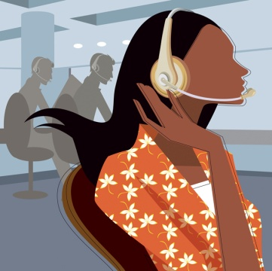
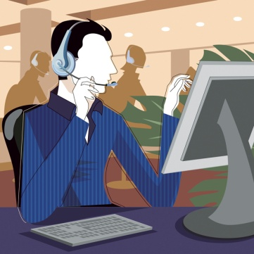
Answering caller enquiries or transferring calls
To respond effectively yourself to caller enquiries:
Apologise – if appropriate – for the need to transfer the call
Explain why you need to transfer the call
Tell them who you want to transfer them to
Ask permission to transfer their call
Transfer the call and monitor it.
Notes:
Trainer informs students their workplace may have standard protocols for them to follow when transferring calls and if they exist they must be adhered to.
Trainer indicates standard telephone procedures for transferring calls include:
Apologise – if appropriate – for the need to transfer the call. Where the caller has asked for another person there is obviously no need to apologise
Explain why you need to transfer the call. Highlight the fact the person they are being transferred to will be best able to deal with their call
Tell them who you want to transfer them to . Give the person’s name and tile/position within the business
Ask permission to transfer their call, for example:
“Mr Watts, I’m sorry I can’t help you with your query but I’d like to transfer you to Mr Brown who is the manager. Would you like to be connected to him?– I’m sure he will be able to give you the information you need”
Transfer the call and monitor it . If the call isn’t answered you must go back to the caller, apologise and make arrangements for the business or person to phone the caller back.
Class Activity – Demonstration and practical exercise
Trainer uses the Training Institute telephone system to demonstrate to students how to transfer a telephone call [Trainer may elect to use reception or administration staff to demonstrate this] and then:
Uses Training Institute telephone system to call students and request someone or a department that will necessitate students transferring the call.

Slide 25

Answering caller enquiries or transferring calls
To respond effectively yourself to caller enquiries:
Apologise
Ask if they know who might be able to help them – or suggest someone
Ask if you can take a message and have the person ring them back
Pass the message on to the appropriate person
Monitor the action taken in response to the call.
Notes:
Trainer advises students where the caller has asked to talk with someone who is unavailable they should:
Apologise and tell them the person is unavailable but do not disclose where they are or why they are away
Ask if they know of anyone else who might be able to help them. This may involve you politely asking them the reason for their call so you can place it appropriately, or suggest another person who may be able to assist
Ask if you can take a message and have the person concerned ring them back. Then take a short but comprehensive message, repeating back the details to the caller (see section 1.5 for more details)
Pass the message on to the appropriate person to make sure they receive the message. Always remember taking a message is only part of the job. It is equally important to make sure it is passed on (see section 1.6)
Monitor the action taken in response to the call. For example, if the person who was required to reply to the call cannot be contacted, or is unable to answer, then you must provide quality service by telephoning the caller and advising them that even though their call has not been answered as intended, it has not been forgotten and will be dealt with shortly (by another person, where appropriate). You must keep trying to contact the caller, in this situation, until you are able to speak with them. It is not acceptable to ring once, be unable to talk to them and then ignore the situation.

Slide 26
Answering caller enquiries or transferring calls
If you cannot answer questions asked, an appropriate response is:
Apologise
Ask caller if you can make some enquiries yourself and get back to them
Take their details and details of the query
Thank them for their call
Find out the required answers
Phone them back – as and when arranged or promised.
Notes:
Trainer informs students in some cases they will be the person who the caller needs to speak to, and they will be unable to answer all questions asked of them. When this occurs an appropriate response is to:
Apologise quickly and sincerely. If you don’t know the answer to a question then the sooner you identify this and inform the caller, the better
Ask the caller if you can make some enquiries yourself and get back to them. Remember to ‘ask permission’ rather than ‘tell them’ what you are going to do
Take their details and details of the query. Write down their contact details, ask the best time to call back and capture all the details about the query
Thank them for their call and confirm you will phone them back at the agreed time on the agreed number
Find out the required answers. Ask other staff, research price lists, policies, schedules, menus etc.
Phone them back as and when arranged or promised. If there is difficulty obtaining the required information follow procedures as set out on next slide.

Slide 27
Answering caller enquiries or transferring calls
If you are having difficulty obtaining answers to their questions:
Ring them
Apologise
Explain the situation
Let them know you are still following up
Make a time to phone them back with the required answers.
Notes:
Trainer informs students if they are having difficulty obtaining answers to callers questions as promised they should:
Ring them and let them know you have not yet got the answer
Apologise – sincerely but briefly
Explain the situation – inform them why you are having difficulty (for example, the person you need to talk to may be away; the system may have crashed)
Let them know you are still following up to demonstrate you are working for them and on their behalf
Make a time to phone them back with the required answers and repeat this process where you still cannot find answers.

Slide 28

Answering caller enquiries or transferring calls
Tips to follow when transferring a telephone call include:
Transfer calls promptly
Locate the required person for the caller
Not transferring calls to people you know are not there
Only try to transfer a call once to an extension
Give caller choices if the required person is unavailable.
Notes:
Trainer provides students with tips to follow when transferring a phone call to another extension:
Transfer calls promptly. Quickly identify if there is a need to transfer the call or not
Locate the required person for the caller where necessary or appropriate, while the caller is on hold. Do this quickly and advise them there is a call for them
Not transferring calls to people you know are not available. There is no point transferring a call to, for example:
Someone you know is away, sick
Someone who is on another call, or busy with a face-to-face customer
Only try to transfer a call once to an extension. It is standard practice in most workplaces not to re-try transferring a call to an extension that was busy or unavailable
Give caller choices if the required person is unavailable, such as:
Continuing to hold
Leaving a message
Having the business call them back
Calling back again later.

Slide 29
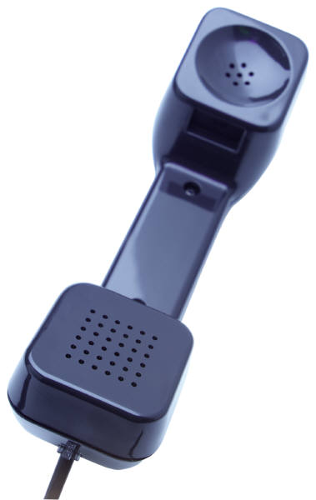
Answering caller enquiries or transferring calls
All promises made on the telephone must be kept, when promised, as promised.
Keeping promises made on the telephone:
Builds confidence
Values and respects the caller
Differentiates the business from others.
Notes:
Trainer stresses to students that all promises made on the telephone to a caller must be kept.
Trainer explains by stating (for example):
If a promise is made to call them back then they must be called back
If a promise is made that Mr. Sing will call back, Mr. Sing must call back
If a promises was made to call back before 5:00PM, the call must be made back to them before this time.
Trainer highlights that keeping promises made on the telephone is a great way of:
Building customer or caller confidence in the business. If promises made on the telephone are honored, callers believe other promises made by the business when they do business with them will also be honored
Valuing the business of the caller by demonstrating the organisation wants to do business with the caller
Respecting the caller by extending the common courtesy of doing what was promised
Differentiating the business from nearly every other business. Most other businesses do not keep their promises so this is a simple and effective way to show how your business differs to the competition.

Slide 30
Recording and passing on messages
Where a telephone message has to be taken, do so:
Cheerfully
Using the designated telephone message form
Making sure you capture all the information the caller gives you
Ensuring you get the details correct
Repeating the message back to the caller to confirm it
Thanking the caller.
Notes:
Trainer instructs students if the caller asks to leave a message or it becomes obvious a message needs to be taken, high levels of customer service must be provided and they must be on their guard to never give the impression that having to take a message is a nuisance or a burden.
Trainer explains taking a telephone message must be done:
Cheerfully. The same level of customer service must be provided as dealing with all other aspects of telephone operation.
Using the designated telephone message form – see following slide
Making sure you capture all the information the caller gives you. The message must be meaningful and comprehensive. Remember another person will have to read, interpret and act on it
Ensuring you get the details (times, dates, numbers, prices, addresses, flight numbers etc.) correct – double-check them. Special attention needs to be paid to spelling of names, addresses, towns etc. Ask the caller to spell out names and destinations if unsure of the spelling or where variations on traditional spelling exist
Repeating the message back to the caller to confirm it and allow them to provide extra information or detail or change the details already provided and make corrections (adjustments, additions etc.) as required
Thanking the caller for their call, leaving a message, calling back etc.

Slide 31
Recording and passing on messages
When a telephone message has been taken it must be passed on:
To the appropriate person
Promptly
In hard copy form.
It is never sufficient just to take a telephone message:
Check the person has picked up their message
Check they have acknowledged your email
Speak to the person to ask if they have received the message.
Notes:
Trainer informs students once a message has been taken it must be passed on:
To the appropriate person or department, as appropriate
Promptly – which translates into ‘as soon as possible’
In hard copy form. It is rarely acceptable simply to pass on a verbal message.
Trainer also advises students that to make sure the appropriate person has received their message they may:
Physically check the staff notice board, or pigeon hole to see whether or not they have picked up their message
Check the email system to verify a Read Receipt has been received acknowledging an email alert/message has been received
Speak one-to-one with the person – in person or over the phone to confirm they have received their message.

Slide 32
Recording and passing on messages
Most businesses use a standard form telephone message pad/form to record telephone messages:
They are ‘duplicate’ – top copy goes to receiver of message; bottom copy stays in book/pad
When recording a phone message:
Write legibly
Put your name or initials on the message
Include caller details
Include ‘action required or promised’.
Notes:
Trainer tells students many businesses have a paper-based message book or a pad of ‘telephone message’ slips for recording telephone messages, highlighting these may be produced by the business for their individual use but most businesses will use a commercially available option found at stationers
Trainer explains:
These books/pads are duplicate in nature. The top copy is given to the person for whom the message is intended and the duplicate or bottom copy stays in the book/pad.
If the top copy is lost, the duplicate copy can always be used as a reference.
When recording a telephone message ensure:
Legibility – remember that someone else has to read it
Put your name/initials on it so the recipient knows who took the message, allowing them to contact you for more information
You record the caller’s name, phone number, nature of the call, query or message, and date and time of the call
What action the recipient is required to take, if any – such as ‘ring back’, ‘forward function Information Kit’ etc: Remember this is a promise made to the caller so it is important it is kept.

Slide 33
Recording and passing on messages
Further points to observe when taking telephone messages:
Use any internal electronic system in place at the business:
Facilitates recording of message
Saves time
Makes distribution of messages easier
Never take messages on scraps of paper:
It is unprofessional
They are easy to lose
They do not prompt you to capture all message details.
Notes:
Trainer informs students that when taking telephone messages:
An electronic option to the paper-based ‘telephone message’ may exist in their workplace. This is either a template facility, intranet or internal email and facilitates both the recording and distribution of telephone messages
The use of scraps of paper to record telephone messages must be avoided at all times because;
They are unprofessional. It looks bad to any customer who sees what you are doing
They are more easily lost. Messages in a telephone message book stay in place until physically removed
They do not prompt the message take to ask the necessary questions. The sections on a telephone message pad function as prompts as to what questions to ask the caller in order to capture all the necessary call details.
Class Activity 1 – Distribution of telephone message forms
Trainer obtains sample telephone message forms and distributes them to students, identifying the sections on the forms and explaining what each is used for.
Class Activity 2 – Exercises/simulation
Trainer arranges for:
Students to answer Training Institute telephone in their class and take a message (on a Telephone message Pad/Form) from another student, playing the role of a customer leaving a message for a staff member or department.

Slide 34

Relaying telephone messages
Check with Supervisor for company procedures for relaying telephone messages. Options include:
Placing in person’s pigeon hole
Pinning it on the staff notice board
Sending the person an email
Physically taking the message and handing it to them
Leaving the person a voice message to let them know they have a message.
Notes:
Trainer reminds students it vital for all telephone messages to be passed on.
Trainer explains to students options for relaying messages may be covered by a company policy (so they must check with their Supervisor) but options may include:
Placing the top copy of the telephone message form into the person’s pigeon hole for them to collect. This is not acceptable where the message is urgent
Pinning it to the staff notice board
Sending the person an email – see previous section re electronic templates for phone messages
Physically taking the message and giving it to the person (handing it to them – this is appropriate where the matter is urgent)
Leaving the person a voice message to let them know they have a message and asking them to (as appropriate) contact you, check their email, pick the message up from their pigeon hole etc.

Slide 35

Relaying telephone messages
Additional points to note regarding relaying telephone message include:
Never leave telephone messages in the telephone message book
Always follow up on messages
Relay all telephone messages promptly
Notify Supervisor where messages have not or cannot be delivered.
Notes:
Trainer provides additional information to students regarding the relaying of telephone messages:
Never leave telephone messages in the telephone message book. It must be forwarded according to need or company policy
Always follow-up on messages to make sure they have been received and/or actioned
Relay all telephone messages promptly. The standard timeline is ‘as soon as possible’
Notify Supervisor where messages have not or cannot be delivered. If a message has not been passed on or actioned in 24 hours the Supervisor should be advised of this.

Slide 36
Reporting threatening or suspicious phone calls
Where you receive a threatening or suspicious phone call:
Adhere to workplace requirements as set out in policies and procedures, on-the-job training
Ask questions
Use specific form to record call and caller details
Alert management as soon as possible
NEVER treat call as a hoax.
Notes:
Trainer informs students they must determine what the workplace protocols are for handling threatening and/or suspicious phone calls and adhere to those at all times.
Trainer identifies suspicious or threatening phone calls as:
Bomb threats
Hold-up threats
Threats to staff members
Threats of retribution
Threats to damage property
Nuisance or prank callers.
Trainer advises students if they receive a threatening or suspicious phone call they should:
Follow workplace procedures for dealing with threatening or suspicious calls. There is a need to become familiar with those procedures now. Do not wait to receive a threatening call before finding out
Ask questions. It is important to ask questions of the caller when they make their threat [see next slide for examples]
Use the dedicated form to record such calls. Know where the form is kept to record details of threatening calls and use it because it contains prompts about what questions to ask and about what information about the call and/or caller to record
Alert management or the identified chain of command immediately without alarming customers or causing panic
Never treat any threatening or suspicious call as a hoax. Every call must be considered genuine. This means always reporting the call to your Supervisor immediately and undertaking planned responses (which may include evacuation, notifying the authorities, following the directions for the business as set out in the Emergency Management Plan for the business).

Slide 37
Reporting threatening or suspicious phone calls
If you receive a bomb threat phone call:
Record the call on a Bomb Threat form
Ask lots of questions such as [see Bomb Threat Form/Checklist]:
What kind of bomb is it?
What will cause it to explode?
Why did you plant it?
Alert nearby staff you are taking a bomb threat
Treat every call as genuine.
Notes:
Trainer informs students they should use a dedicated form to capture information about a bomb threat call stressing they should:
Ask the caller lots of questions such as:
“Who are you?”
“What does the bomb look like?”
“When is the bomb due to explode?”
“Why did you plant the bomb?”
“How can we defuse it?”
Alert nearby staff you are receiving a bomb threat by waving arms, writing a note, activating a silent alarm
Treat the call as genuine every time, regardless of personal thoughts about the call
Class Activity – Discussion of Bomb Threat Procedures and Checklist
Trainer downloads document from http://www.dhs.gov/xlibrary/assets/ocso-bomb_threat_samepage-brochure.pdf and:
Presents copy to students
Discusses implementation of the procedures
Demonstrates use of Checklist.

Slide 38
Using appropriate language, tone and volume
Standard requirements when answering or using a phone are:
Being polite and respectful
Speaking correctly and distinctly
Not using slang, jargon or other unacceptable language.
Notes:
Trainer informs students standard requirements when answering or using the telephone are:
Being polite and respectful to all callers, regardless of:
Their age, gender or nationality
Other work pressures you are under
Time of day. Treat the last call of the day with the same care and attention as the first call of the day
Speaking correctly and distinctly – not mumbling, speaking directly into the phone, eliminating background noises that can hinder communication or cause a barrier to communication
Not using slang, jargon or other unacceptable language. This includes not using trade or industry terms that the customer may not be familiar with or may not know the true meaning of.

Slide 39
Using appropriate language, tone and volume
Your voice must convey warmth, interest, sincerity and a willingness to be of service and assistance but at times you may need to ‘match your voice to the call’ :
You can raise your voice if the environment is noisy, caller has asked you to or caller has difficulty hearing
You can use industry or business terminology where caller is familiar with your business/ or industry
You can change tone of voice where the focus of the call indicates or demands you do so
Notes:
Trainer informs students their standard voice on the telephone must be warm and friendly but they should strive to use their discretion or common sense to ensure their voice is matched to the individual call and its needs and the needs of the individual caller.
Trainer identifies for students situations where a departure from ‘standard’ language, tone and volume is appropriate:
There may be instances when you need to raise your voice. The caller may be in a noisy environment, they may have a hearing difficulty, or they may have asked you to ‘speak up’
There may be times when the language you use needs to be considered and adjusted as required. These may be instances such as:
Dealing with an industry person who is familiar with trade terminology and with whom you can use industry terms quite safely knowing they will understand what is being said
Talking to someone who is a regular patron and is familiar with your business or your operations. This means you can make reference to various facilities, rooms, services in the business knowing they will understand what you are talking about
Talking with a very young or very old person and meeting their expectations in terms of language or words used.
There may also be times where you believe a change in your tone is called for. Perhaps when dealing with someone who is trying to reach a decision and requires lots of information, or someone who is being inappropriately suggestive on the phone.

Slide 40
Using appropriate language, tone and volume
If you receive a call from a person who is rude or aggressive you cannot respond to them in the same way. You:
Must not swear back at someone
Must not use the same tone of voice as used by the caller
Must not use the same style of language
Must not be rude, in return
Notes:
Trainer informs students they may answer a call from a rude or aggressive caller and if this occurs they:
Must not swear back at someone who swore at you in the first place
Must not use the same tone of voice as used by the caller when they are obviously annoyed
Must not use the same style of language. Your responses and the language you use must always remain professional and always reflect the image
Must not be rude, in return. While at work there is never any justification for being rude to any caller or customer regardless of the circumstances.

Slide 41

Using appropriate language, tone and volume
Keys to respond effectively to rude or aggressive callers are:
To remain calm and in control
To not respond with anger
To remain polite
To not take the call personally
To get to the reason for the call as quickly as possible.
Notes:
Trainer provides students with techniques to deal effectively with rude or aggressive calls:
To remain calm and in control. This may be achieved by:
Taking a deep breath mentally
Recognising the call for what it is. It is an unusual call (that is, accepting most calls are not like this): do not allow this call to spoil your day or ruin your reputation
Seeing the call as a challenge rather than a problem/issue and doing your best to meet the challenge the call presents
To not respond with anger regardless of how much you may feel like it, feel it is appropriate, or are being provoked. You must respond calmly in order to try to calm the other person down
To remain polite in your responses – using ‘Sir’, ‘Madam’, please’ and ‘thank you’. The theory being the more polite you are, the more you encourage a similar response from the caller
To not take the call personally. Try to remember the caller is not upset with you personally, instead they are angry at someone or something else. You just happened to be the one who picked up the phone so never believe their anger, rudeness, sarcasm, tone of voice is directed at you
To get to the reason for the call as quickly as possible by redirecting their statements (criticisms, nastiness) back to the real point of the call (that is, what they want to discuss). You need to cut through their initial anger as quickly as possible and start addressing their real problem:
“Yes, Sir I can tell you are upset and I apologise. Will you allow me to transfer you to Mr Smith, our manager, so he can talk to you? He has the authority to deal with this kind of issue”

Slide 42
Summary – Element 1
When responding to incoming telephone calls:
Answer all calls as soon as possible using the business-approved greeting
Display a friendly and helpful demeanour that demonstrates your willingness to be of service
Quickly identify the caller’s reason for phoning and provide the required assistance promptly or re-direct the call so someone else can deal with the call
Be prepared to clarify caller details, booking details or the reason for the call
Make sure all telephone messages are recorded accurately and comprehensively and forwarded to the appropriate person
(Continued)
Notes:
Trainer provides a recap of the Element asking questions to check student understanding and responding to questions from students, as required.

Slide 43
Summary – Element 1
Follow-up on all telephone messages taken to ensure they have been received and/or actioned
Treat all suspicious or threatening phone calls seriously and report them immediately to your Supervisor
Always use language, tone and volume appropriate to the nature of the call to demonstrate respect for the other person and to show their call is valued.
Notes:
Trainer provides a recap of the Element asking questions to check student understanding and responding to questions from students, as required.

Slide 44
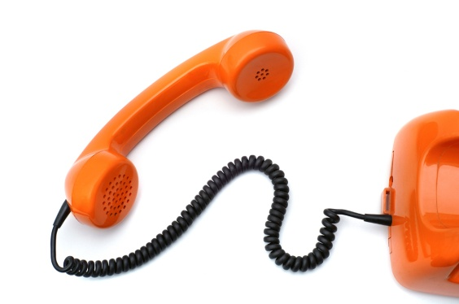
Make telephone calls
Performance Criteria for this Element are:
2.1 Obtain correct telephone numbers
2.2 Establish clearly the purpose of the call prior to calling
2.3 Use telephone equipment correctly
2.4 Communicate clearly your name, company and reason for calling
2.5 Be polite and courteous at all times.
Notes:
Trainer identifies for students the Performance Criteria for this Element, as listed on the slide.

Slide 45

Obtaining correct telephone numbers
Dialing the wrong number:
Is embarrassing
Can cause bad PR
Costs money
Wastes time.
Notes:
Trainer explains to students there can be numerous reasons to make an outgoing phone call from work.
Class Activity – General discussion
Trainer asks students for examples of reasons why they may have to make an outgoing telephone call from a workplace and writes them on board.
Possible reasons/answers may include:
Confirm a reservation with a booking holder
Place an order with a supplier or lodge a booking with a provider
Follow up a customer enquiry by phoning the customer back
Follow up a customer complaint
Make an enquiry or find information
Promote a service, facility or product
Pass on messages.
Trainer stresses it is important for students to obtain the correct telephone number before dialing as not doing so can:
Be embarrassing – to you especially when you do so in front of a customer who is waiting on the outcome of the call
Lead to bad public relations – for the business when the other party knows who made the call
Cost money – every phone call costs the business money
Waste time – in re-dialing; in finding the correct number – it is often, therefore, quicker, to find the correct number in the first place.

Slide 46

Obtaining correct telephone numbers
Standard ways to obtain the correct number for a call you want to make are:
Use speed dial
Search online directory
Read a document from the person/company
Search workplace database
Contact ‘Directory Assistance’.
Notes:
Trainer advises students the standard ways of determining the ‘correct’ telephone number for a call they want to make are:
Use speed dial, making sure all numbers in the speed-dial facilities are updated as required when organisations change their numbers
Search online directory using the Internet facilities at your workplace. It is a good idea to Bookmark commonly used Telephone Directory information sites from different countries or areas
Read a document from the person or company. A letter from a customer may contain their phone number. Most documents from suppliers or providers will feature their telephone number and there will often be a Freecall number
Contact ‘Directory Assistance’ and ask them for the required number.

Slide 47


Obtaining correct telephone numbers
When intending to make a call to another country:
Obtain all the necessary codes and numbers to enable the call to be made
Always use Freecall numbers where they exist
Factor in time zones differences to the timing of when the call is placed
Obtain the necessary details for the person or business to be contacted.
Notes:
Trainer advises students that when they search for an international number they must make sure they:
Obtain all the necessary codes and numbers to enable the call to be made:
Country code
Area code
Number for the business/person
Freecall number.
Always use Freecall numbers where they exist to save money for the workplace
Factor in time zones differences to the timing of when the call is placed to avoid placing a call at an inappropriate time where this is relevant
Obtain additional call details as necessary, such as name of person or department to be spoken to and their title position.
Class Activity – Research exercise
Trainer provides students with the names of five organisations in different countries and asks them:
To find out the full telephone number including Country, Area and other codes necessary to make the call
To identify the local time each call would need to be placed to contact the other country at 10:00AM their time.

Slide 48
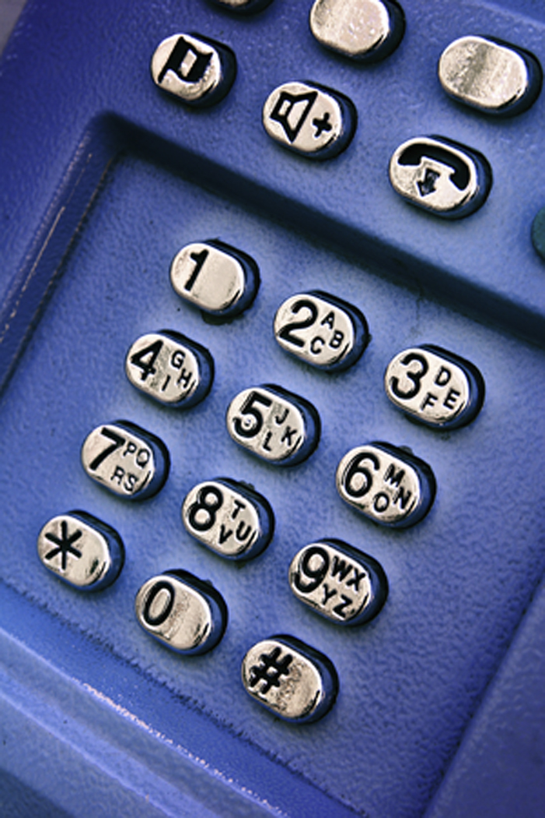
Obtaining correct telephone numbers
You should plan all telephone calls you make. This often only takes a second and has the potential to avoid many negative results:
Confusion
Failure to achieve what was the intended purpose of the call
Time wasting
A poor image or reputation for the business
Loss of business.
Notes:
Trainer identifies to students a common fault people make when making a phone call is to dial the number and then try to work out what it is they are going to say which often results in:
Confusion for all parties. It is much more difficult for the other party to understand what you are saying and what you want if you do not know
Failure to achieve what was the intended purpose of the call. Failing to plan increases the chances of you not securing information you wanted, not passing on necessary information etc.
Time wasting. A call that fails to achieve its intended outcomes often has to be repeated. The ‘waste of time’ refers to a waste of time for the business and for the other party (customer, supplier, provider)
A poor image or reputation for the business which may result in others not referring potential customers to us. They may also tell others about our unprofessional attitude and approach
Loss of business as the other party loses confidence in the organisation.

Slide 49
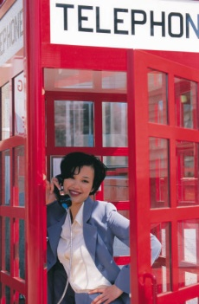
Obtaining correct telephone numbers
Plans and preparations before making a call should include:
Establishing the purpose of the call
Determining who you need to speak to
Making sure all material you will need to use or refer to is nearby
Ensure pen and paper are close by
Make the environment as quiet as possible.
Never use workplace phone for making private calls.
Notes:
Trainer explains to students in order to optimise the chances of making an effective telephone call, before making the call they need to:
Establish the purpose of the call. Why are you phoning this person or organisation? What is it you want to achieve? Do you want to obtain information or provide it? Exactly what information needs to be captured or given?
Determine who you need to speak to. If you do not know a person’s name you should at least determine which department or area you need to make contact with
Have all relevant information at your fingertips depending on the reason for the call. This could include:
Previous correspondence with that person or organisation
Lists or brochures relating to products or services, including price lists, special deals/offers, product information sheets, menus, flight/tour schedules
Details on the important points of the discussion you want to have with the other person such as the details of an offer, the parameters of any negotiation you intend entering into, process details, dates, times, numbers/statistics. Make sure you only ever negotiate with people within your specified scope of authority and be prepared to pass the call on to a Supervisor or other appropriate person when these limits are reached and/or there is need for the negotiation to go beyond these boundaries.
Ensure pen and paper are close by to record any information given by the other party
Make the environment as quiet as possible – close doors, turn down or turn off music etc.
Trainer states to students it is never acceptable to use the work phone to receive or make private phone calls, highlighting this is unacceptable in all workplaces as it costs the employer time and money.

Slide 50
Obtaining correct telephone numbers
You may be required to record details of outward calls in a nominated ‘register’ or ‘book’ . Details may relate to:
Date and time of the call
Who placed the call
Who the call was to and who was spoken to
Reason for the call.
Notes:
Trainer advises students that some organisations maintain a ‘Calls Out’ book/’Outward Calls’ register requiring them to log all calls placed detailing all or some of the following:
Date and time of the call. The duration of the call may be required where the call is international or out-of-area
Who placed the call – by name or initials
Who the call was to or who was spoken to, meaning the name of a person, company or organisation has to be entered
Reason for the call – ‘Confirm booking’, ‘Cold call’, ‘Return call’ etc.
Class Activity – Outwards Calls Register
Trainer obtains a sample Outwards Calls Register (or book, or similar – the one used by the Training Institute may be suitable) and:
Shows it to students
Explains each heading
Illustrates the use of the book/register by reference to entries made.

Slide 51
Using telephone equipment correctly
In order to use your workplace telephone equipment correctly you must:
Realise the workplace system and equipment is different to your home phone
Obtain training
Follow manufacturer’s instructions
Apply workplace telephone procedures
Notes:
Trainer notes to students the telephone at work is likely to be different to what they use at home. He/she explains that, while there are certainly going to be similarities between their home phone and their work phone, the work phone is generally part of a larger system, has many more facilities, and commonly requires them to undertake some form of training to become fully competent in its use.
Trainer states to students their ability to operate the system or equipment properly will depend on:
Obtaining training which can include:
Attending a course conducted by the supplier or manufacturer of the system. This is only an option for those who live in or near a capital city in most cases. In limited cases, the supplier may also make an on-site visit to train staff. This usually only applies where a new system has been installed and is not generally available to individual staff as they join an organisation as a new staff member
Reading the manual or instructions and practicing with the system as you read to assist in becoming familiar with how it operates
Receiving on-the-job training. This is the most common and features an experienced operator explaining the system to you. It involves you watching and listening to them and then you gradually take over progressively more complex tasks as you learn the system and gain confidence and competency
Attending in-house training courses. Some establishments will offer training in their training room in relation to what the phone system can do, and how to use it.

Slide 52
Using telephone equipment correctly
When learning about how to use your workplace telephone system focus on:
Identifying the parts and components of the system
Learning how to answer a call
Learning how to place a call on hold
Learning how to transfer a call
recognising the different tones relating to the system
(Continued)
Notes:
Trainer explains to students they will only need to learn how to use the telephone system and equipment as it exists within their workplace suggesting their effort should be focused on:
Identifying the parts and components of the system – buttons, lights, displays, add-on and integrated components
Learning how to answer a call – both an internal call and an external - as well as learning how to identify the difference between these calls
Learning how to place a call on hold
Learning how to transfer a call
recognising the different tones relating to the system. Most systems produce a different tone to distinguish between internal incoming calls and external incoming calls.

Slide 53
Using telephone equipment correctly
Learning and deciphering the display
Being able to use the call monitoring features
Using the speed dial
Using last number redial
Using handsets and headsets.
Notes:
Trainer continues to identify for students the aspects of a workplace telephone system and equipment they should focus on learning:
Learning and deciphering the display on the handset/console
Being able to use the call monitoring features as specific to individual systems, makes and models
Using the speed dial which will involve finding out about the numbers and associated contacts entered into the speed dial facility (this may be a paper-based list or a system-based display on the handset/console)
Using last number redial
Using handsets and headsets.

Slide 54
Using telephone equipment correctly
You should also learn the ‘advanced features’ of your workplace telephone, such as:
Activating ‘call forward’ for individual numbers
Activating ‘call back’ for individual numbers
Recording voice messages such as greetings
Setting up conference calls
Initiating ‘Do Not Disturb’ for designated numbers
(Continued)
Notes:
Trainer highlights to students individual systems vary depending on their size, cost and the needs of the business and learning the advanced features may cover things such as:
Activating ‘call forward’ for individual numbers. This forwards an incoming call to a designated number if the extension does not answer within a given number of rings
Activating ‘call back’ for individual numbers
Recording voice messages such as greetings
Setting up conference calls. This is used by many businesses, especially where they have numerous offices in different countries or locations
Initiating ‘Do Not Disturb’ for designated numbers. This is important in businesses where staff or management are in conferences or meetings and do not want to be interrupted.

Slide 55
Using telephone equipment correctly
Initiating password protection
Establishing call groups
Adding, deleting and amending system details
Operating system features that integrate with other systems
Using programmable keys or buttons.
Notes:
Trainer continues to identify the ‘advanced features’ of a telephone system that students should strive to learn how to use:
Initiating password protection on designated lines or numbers
Establishing call groups for ease of use
Adding, deleting and amending system details for nominated internal lines or numbers
Operating system features that integrate with other systems such as pagers, call costing, wake and reminder calls, barring or limiting calls to and from designated numbers, messaging etc.
Using programmable keys or buttons as appropriate to the individual workplace.

Slide 56
Communicating name, company and reason for calling
When making a call from work, you should, when the other party answers the call:
State your name
Identify the business you represent
Advise them of the reason for your call.
Try to avoid playing ‘phone tag’.
Notes:
Trainer explains to students that whenever they make a call from their workplace they should begin the call when it is answered by:
Stating your name clearly: the name may be your full name (that is, first and surname), or just the first name (in accordance with workplace standards)
Identifying the business you represent according to accepted or required format: that is the words ‘proprietary’, ‘company’, ‘limited’ and certain other words are commonly omitted
Advising them of the reason for your call or the person you want to speak with.
Trainer explains to students that ‘phone tag’ is where they ring someone and the person they want is unavailable, so they leave a message or their number. The other person then returns their call and finds the person who left the message is unavailable, so they leave a message. The first caller then phones back … and the cycle continues.
Trainer indicates some organisations and/or individuals prefer not to get caught up in this ‘game of tag’ and will neither leave a message nor give a return number. Their preference may be to keep control of the communication by deciding it is best if they retain the decision about when to make the call and speak to the other person.
Trainer recommends students talk to their Supervisor and see if their employer has any preferences in this regard, stressing most businesses will want a message to be left where:
They have promised to call
They have promised to provide information
The matter is urgent.

Slide 57
Communicating name, company and reason for calling
“Good afternoon, it’s Gary Walsh here from Nursery Ridge Travel. Can I speak with someone who can help me with booking desert tours?”
“Good morning, my name is Joe Smith from the reception desk at The Walsh on Lime. I’m phoning on behalf of one of our guests, Mr Graham, who is on hold at the moment and wishes to speak to Emma Gregson about a booking he has with you.”
“Hi, it’s Ryan here from Bob’s Bar and Grill. Can I speak to your accounts department please?”
“Hello, my name is Linda from Catering and Cakes and I wanted to speak to someone about obtaining information on the products you supply to retail outlets. We’re thinking of changing suppliers and I wanted to get some quotes.”
Notes:
Trainer explains to students that stating their name, the business they represent and their purpose for calling must be done in accordance with enterprise standards.

Slide 58
Being polite and courteous at all times
You must be polite and courteous when answering or placing a call:
Always say ‘please’
Always say ‘thank you’
Mention appreciation of special effort the other person has made
Always remain a professional
Never run down a third party to the person you are speaking to
(Continued)
Notes:
Trainer states to students that in the same way they are expected to be polite and courteous when taking a telephone call, so too are they expected to be polite and courteous when making a call.
Trainer presents points to note when taking or making a call include:
Always say ‘please’ when asking for something
Always say ‘thank you’ when provided with information or assistance that was required
Make mention of your appreciation of any special effort the other person has made on your behalf such as extra effort in locating a certain person, finding required information, making a sensible suggestion that may not have solved your problem but has helped it along the way
Always remain a professional even when the other party may be rude, unhelpful, or extremely unprofessional themselves
Never run down a third party to the person you are speaking to. For example, don’t mention to the person in Accounts the person on the switchboard was slow, or unhelpful.

Slide 59

Being polite and courteous at all times
Ask when a person who is unavailable is likely to be available
Use the person’s name if known
Speak at a normal volume
Talk at a normal rate
Use correct language
Avoid using industry terms and/or business-specific terminology unless speaking to another industry professional
(Continued)
Notes:
Trainer continues to present points to note when taking or making a call:
Ask when a person who is unavailable is likely to be available or ask them when the best time to call is
Use the person’s name if known or use ‘Sir’ or ‘Madam’ according to business protocols when talking to a caller
Speak at a normal volume – don’t whisper and never shout
Talk at a normal rate – don’t rush the call
Use correct language – don’t swear, never use slang expressions, don’t joke (many complaints have arisen as a result of a staff member making what they thought was a funny comment but which the other person didn’t find at all humorous); don’t make racist, sexist or ageist comments
Avoid using industry terms and/or business-specific terminology unless speaking to another industry professional – this can confuse people outside the organisation and make them feel they are being excluded from the conversation.

Slide 60


Being polite and courteous at all times
Eliminate any background noise as far as possible
Talk directly into the phone or headpiece/mouthpiece
Pronounce your words correctly
Spell out any words you can expect the other party will be unfamiliar with
Be careful how you put the phone down when you are talking to the caller
Never talk to a third party while you are on the phone to someone else
(Continued)
Notes:
Trainer continues to present points to note when taking or making a call:
Eliminate any background noise as far as possible – turn off radios/music; close doors and windows to reduce noise from other areas
Talk directly into the phone or headpiece/mouthpiece to optimise likelihood of other person understanding
Pronounce your words correctly to facilitate correct hearing
Spell out any words or terms you can realistically expect the other party will be unfamiliar with
Be careful how you put the phone down when you are talking to the caller. Put it down gently to avoid noise to the other party
Never talk to a third party while you are on the phone to someone else – it is rude, unprofessional and distracting.

Slide 61

Being polite and courteous at all times
Ask callers if you can help them in any other way before hanging up
Thank callers for their call
Let the caller hang up before you do.
Notes:
Trainer continues to present points to note when taking or making a call:
Ask callers if you can help them in any other way before hanging up. This applies to ending incoming calls
Thank callers for their call, where appropriate. Once again, this only applies to incoming calls
Let the caller hang up before you do just in case they think of a last-minute statement they want to make, or question they want to ask.

Slide 62

Summary – Element 2
When making telephone calls:
Always prepare in advance before placing a call
Obtain the correct telephone number
Determine what you want to achieve as the outcome of the call
Identify who you need to speak with
Plan what you are going to say
(Continued)
Notes:
Trainer provides a recap of the Element asking questions to check student understanding and responding to questions from students, as required.

Slide 63
Summary – Element 2
Use the workplace telephone system in accordance with the manufacturer’s instructions and workplace protocols
Identify yourself, the name of the organisation you represent and the reason for your call when making contact with the other party
Do not use the workplace telephone for private calls
Maintain a polite and courteous manner at all times.
Notes:
Trainer provides a recap of the Element asking questions to check student understanding and responding to questions from students, as required.
Trainer thanks students for their attention and encourages them to apply course content in their workplace activities.

